Slide 1
LEAST SQUARE ERROR METHOD
In most of the cases, the data points do not fall on a straight line (not highly correlated), thus leading to a possibility of depicting the relationship between the two variables using several different lines.
Selection of each line may lead to a situation where the line will be closer to some points and farther from other points. We cannot decide which line can provide best fit to the data.
Method of least squares can be used to determine the line of best fit in such cases. It determines the line of best fit for given observed data by minimizing the sum of the squares of the vertical deviations from each data point to the line.

Slide 2


Method of Least Squares
To obtain the estimates of the coefficients ‘a’ and ‘b’, the least squares method minimizes the sum of squares of residuals. The residual for the i^{th} data point e_{i} is defined as the difference between the observed value of the response variable, y_{i}, and the estimate of the response variable, ŷ_{i}, and is identified as the error associated with the data. i.e., e_{i} = y_{i}–ŷ_{i} , i =1 ,2, ..., n.
The method of least squares helps us to find the values of unknowns ‘a’ and ‘b’ in such a way that the following two conditions are satisfied:
Sum of the residuals is zero.
Sum of the squares of the residuals E ( a , b ) =
is the least

Slide 3
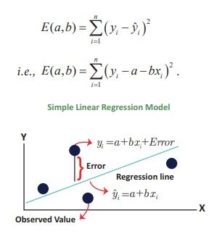
Fitting of Simple Linear Regression Equation
The method of least squares can be applied to determine the estimates of ‘a’ and ‘b’ in the simple linear regression equation using the given data (x₁,y₁), (x₂,y₂), ..., (x_{n},y_{n}) by minimizing

Slide 4
Here, yˆi = a + bx _{i} is the expected (estimated) value of the response variable for given x_{i}.
It is obvious that if the expected value (y^ _{i}) is close to the observed value (y_{i}), the residual will be small. Since the magnitude of the residual is determined by the values of ‘a’ and ‘b’, estimates of these coefficients are obtained by minimizing the sum of the squared residuals, E(a,b).

Slide 5
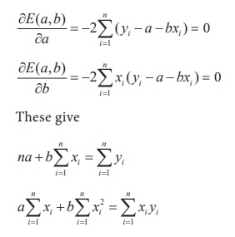
Differentiation of E(a,b) with respect to ‘a’ and ‘b’ and equating them to zero constitute a set of two equations as described below:

Slide 6
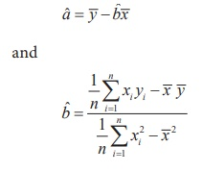
These equations are popularly known as normal equations. Solving these equations for ‘a’ and ‘b’ yield the estimates ˆa and ˆb.

Slide 7

It may be seen that in the estimate of ‘ b’, the numerator and denominator are respectively the sample covariance between X and Y, and the sample variance of X. Hence, the estimate of ‘b’ may be expressed as

